Slide 1

MANUALS

Slide 2

Contents
Manuals
Principles of a good Manual
Types of Manuals
Contents of a manual
Importance
How to write a Manual?

Slide 3

Definition of Manual
Manual is a technical communication document intended to give assistance to people using a particular system.
A user guide or user's guide also commonly known as a manual.
It is usually written by a technical writer.

Slide 4
Definition of Manual
User guides are most commonly associated with electronic goods; computer hardware and software.
Manuals are universal documents that can be understood by ordinary people. It explains certain operations and processes of different departments. With a Manual, company can have a standard for its operations.

Slide 5
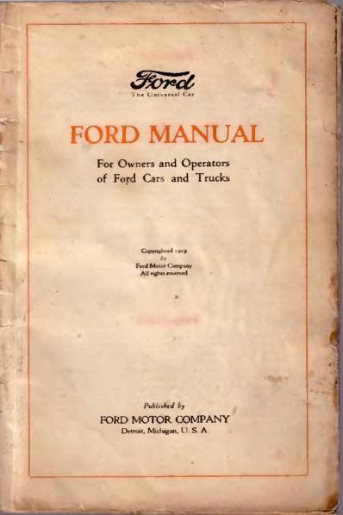
SAMPLE MANUAL
EXAMPLE

Slide 6

TYPES OF MANUAL

Slide 7
Types of Manuals
Policy Manuals
Document the rules governing an organization. It can be set out at the board, organization, departments and other levels.
Procedure Manuals
Document how things are made. Step by step procedures and flow diagrams are frequently used.

Slide 8
Types of Manuals
Guidebooks
It contain guidelines for dealing with different situations.
Service manuals
It is used by service technicians or engineers to perform routine maintenance or to troubleshoot and fix problems or breakdowns.

Slide 9
Types of Manuals
Reference manuals
These usually provide detailed information on hardware or software organized for quick reference.
Training manuals
These are basically designed to teach readers something new. It may be self- paced or designed for use with a training course.

Slide 10
Types of Manuals
Operator manuals
These provide detailed instructions for operating instruments or equipment and may include installation and troubleshooting instructions.
User manuals
These contain instructions for installing and using software or hardware and should be organized around user tasks.

Slide 11

Manual includes:
MANUAL
INCLUDES
PROCEDURES
TABLES
DIAGRAMS
CONCLUSIONS
SCREENSHOTS
GRAPHS
CHARTS
IMAGES
Procedures
Tables
Graphs
Charts
Images
Screenshots
Diagrams
Conclusions

Slide 12


Principles of a Good Manual
Organization
You should organize the information properly in a logical order to list and arrange all the details based on the information given.

Slide 13

Principles of a Good Manual
Introductory Explanation
You should explain the main purpose or the objective of the manual to help the readers understand the object being discussed in the manual procedurally.

Slide 14

Principles of a Good Manual
Good Overview
A manual should state the overview of the topic. This way, it could capture the essence of enthusiasts and readers.

Slide 15

Principles of a Good Manual
Clear Operating Instructions
A manual has procedural steps to describe the making of an object.

Slide 16
Applications of Manuals
User Manuals
Employee Handbooks
Lab Manuals
Data Processing Manuals
Business Manuals for Customers

Slide 17

CONTENTS
OF
USER MANUAL

Slide 18


Contents of a user manual
A cover page
A title page and copyright page
A preface
A contents page
A troubleshooting section
A FAQ
Where to find further help and contact details
A glossary and, for larger documents, an index

Slide 19


COVER PAGE:
A book cover is any protective covering used to bind together the pages of a book, giving hint about style or subject of book.

Slide 20

TITILE AND COPYRIGHT PAGE:
A page at the beginning of a book giving its title, the names of the authors, publishers and information about the current edition.

Slide 21
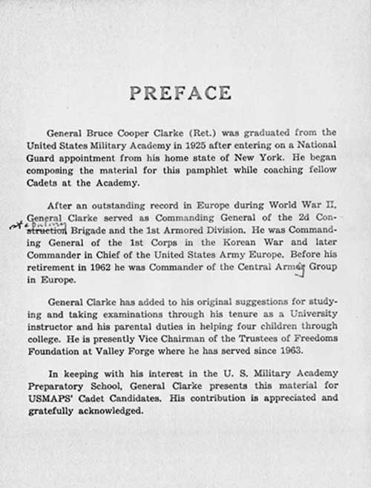
PREFACE PAGE:
A preface is an introduction to a book or other literary work written by the author.

Slide 22
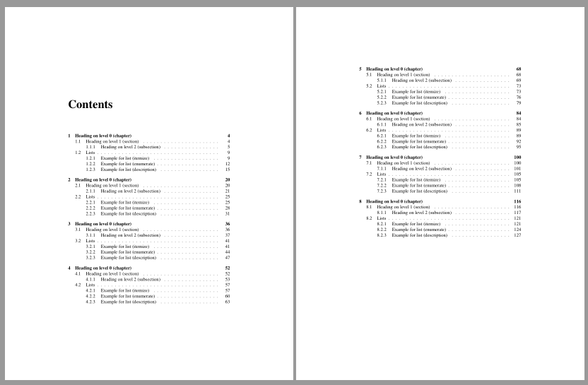
CONTENTS PAGE:
Is a list of section titles or brief descriptions with their commencing page numbers.

Slide 23
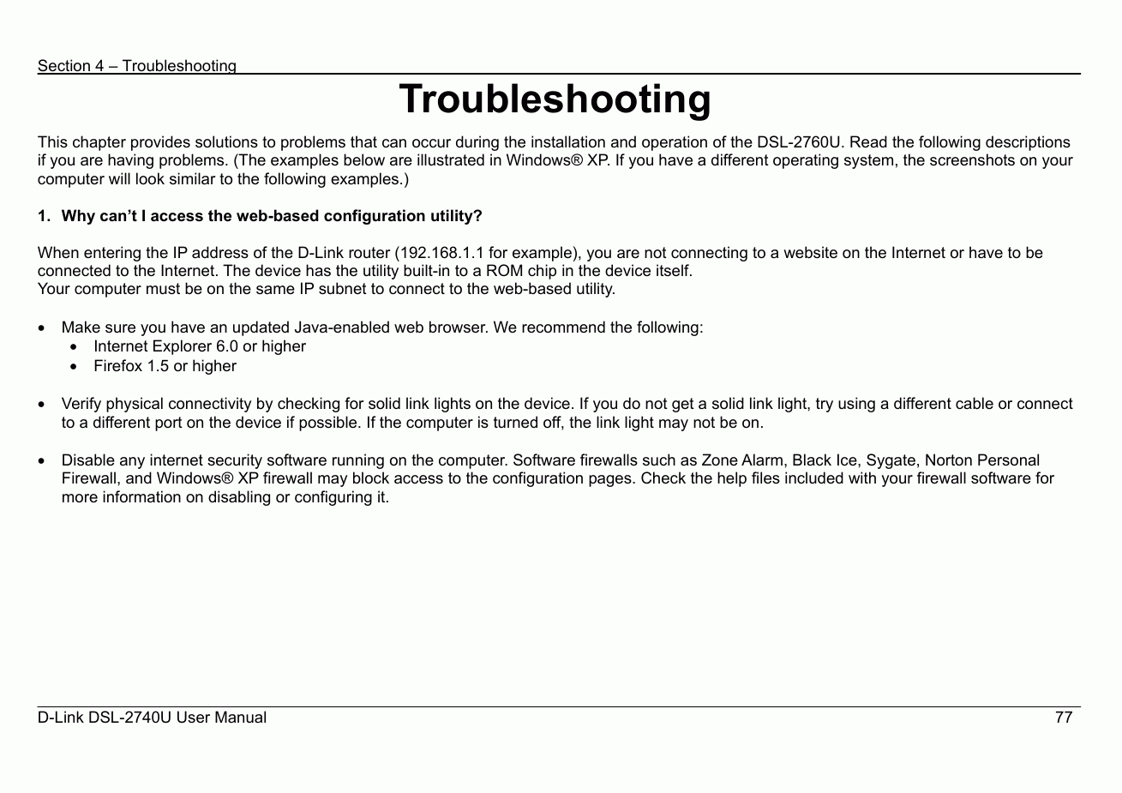
TROUBLESHOOTING PAGE:
Troubleshooting is a form of problem solving.

Slide 24
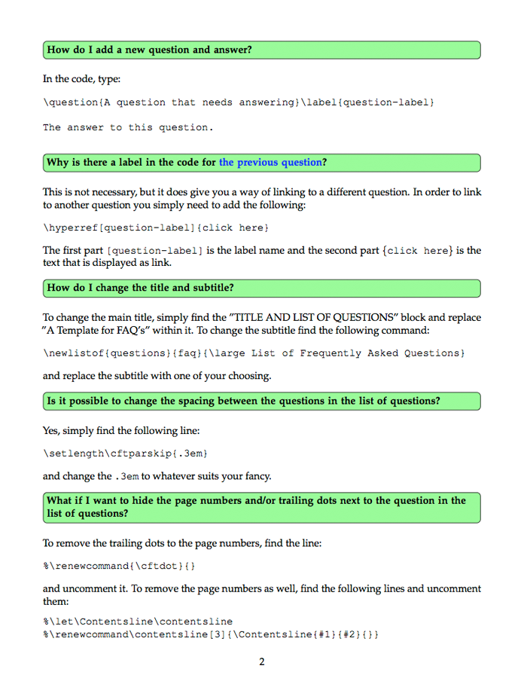
FAQ PAGE:
An FAQ (Frequently Asked Questions) page is a perfect opportunity to display answers to commonly asked questions.

Slide 25
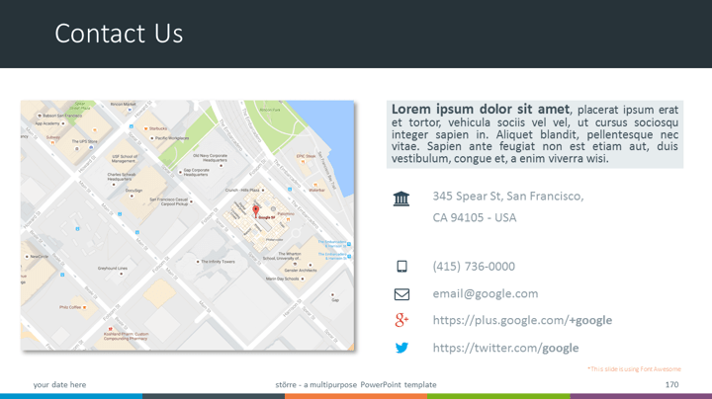
PAGE CONTAINING FURTHER ASSISTANCE AND CONTACT DETAILS:

Slide 26
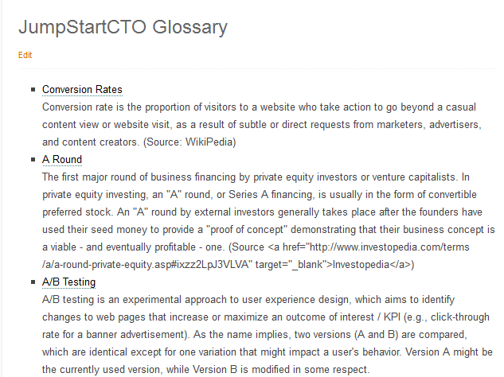
GLOSSARY:
Covers all acronyms and industry terms used in the document. Help the user understand your material.

Slide 27
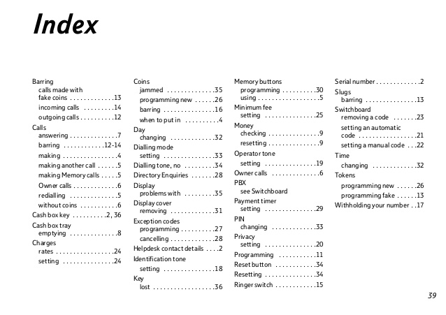
INDEX PAGE:
An index helps users locate specific items very fast without having to search through the entire document manually. Large documents without an index are impossible to use efficiently.

Slide 28

Importance of a Manual

Slide 29


Why do we need a Manual?
Avoid Information Gap Manual gives consistency to the company. It gives us instructions and guidelines on how to do a certain thing or job. For example, when an employee is promoted to managerial position, manuals gives him/her the overview of the roles and responsibilities of that position.
Launching of new products or services When you make a new product or service, you need to provide a Manual that contains the how-to’s, components, functionality, and processes.

Slide 30

Why do we need a Manual?
Valued Customers For customers to gain information about the product. And for consumers to understand the product well and how to get the utmost benefits from the product.
Valuable Tool Manual is a valuable tool for understanding technical knowledge in fields such as law, construction, and finance. It is especially important for consumer electronics products, medical equipment, construction machinery, computer and its accessories.

Slide 31

ADVANTAGES

Slide 32
Advantages:
Reduced Time and Cost to Productivity We can improve the quality of our products and services. There will be lesser complaints and clarifications regarding how to use or how to install our products. For new employees, this will also reduce the time for their training since the Manual would give them the standards and procedures they need to abide by.
Shared Information We can share knowledge and wisdom which are, before, meant for only one person or department.

Slide 33
Advantages:
Reduce and Minimize risks Businesses can avoid having misconceptions or misunderstandings; Having a Manual sets the rules, guidelines and policies of the company operations. Manual also set the standards for the company to ensure profitability and growth.
Maximize potentials Manuals are universal to the company. For example, when a business outsource certain functions, a Manual provides consistency and quality assurance. Referring to a Manual increases the productivity and profitability of the company

Slide 34
Advantages:
Demonstration of Roles & Responsibilities A manual gives the employees a general overview of how the company operates and their respective roles and responsibilities.

Slide 35

ART OF MANUAL WRITING

Slide 36

The Art of Manual Writing
Audience
Which audience you are writing for?
Purpose
Why are you creating the manual?
What are you going to talk about in it?
Scope
Where will be the manual used?

Slide 37



How to write a manual?
Know the objective
What your manuals need to cover?
Subject of manual
Avoid wordy Information and details

Slide 38
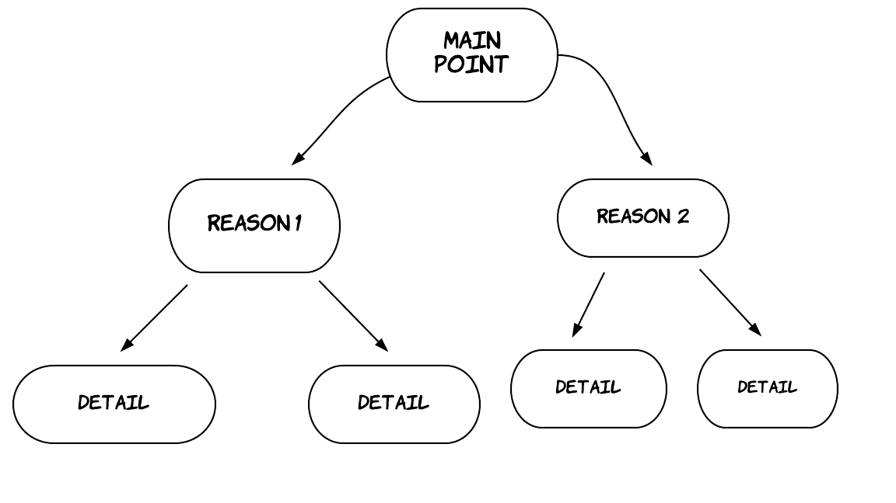
How to write a manual?
Outline it
Main sections and subsections of manuals
Consistently structured

Slide 39
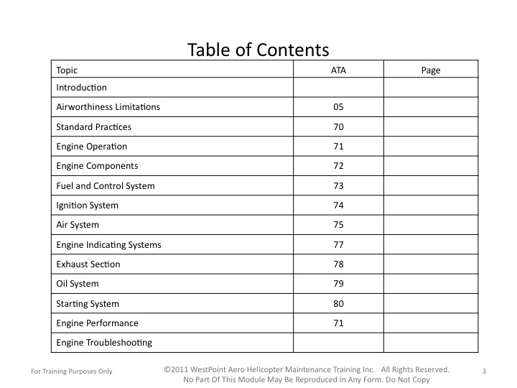
How to write a manual?
Make it easy to understand
Lists and columns to outline steps
Table of contents
Using different features

Slide 40


Writing a manual
Be brief
Focus on interest of audience’s
Be to the point
Avoid jargon

Slide 41

Writing a manual
Use visual aids
To make your manual easier to understand, make use of;
Charts
Graphs
Tables

Slide 42

Writing a manual
Give it a test drive
Or better yet, have someone else who has never seen the material before run through the instructions. Take their feedback and use it to fine tune your manual.

